Slide 1
Lecture 1: Beautiful graphics in R
Trevor A. Branch
FISH507H, Fall 2011
School of Aquatic and Fishery Sciences, University of Washington
catalyst.uw.edu/workspace/tbranch/24589

Slide 2
Tufte: Principles of graphical excellence
Well-designed presentation of interesting data
Complex ideas communicated with clarity, precision, and efficiency
Greatest number of ideas in shortest time with least ink in smallest space
Nearly always multivariate
Requires telling the truth about the data

Slide 3

Napoleon’s campaign to conquer Russia
Original plot by CJ Minard 1861
Tufte, ER 2001 The visual display of quantitative information, p. 41

Slide 4
Tufte: better graphics
Lie factor and exaggeration
Chartjunk
Maximize data:ink ratio
Erase non-data ink
Increase the data density
Label the figures, not the legends

Slide 5
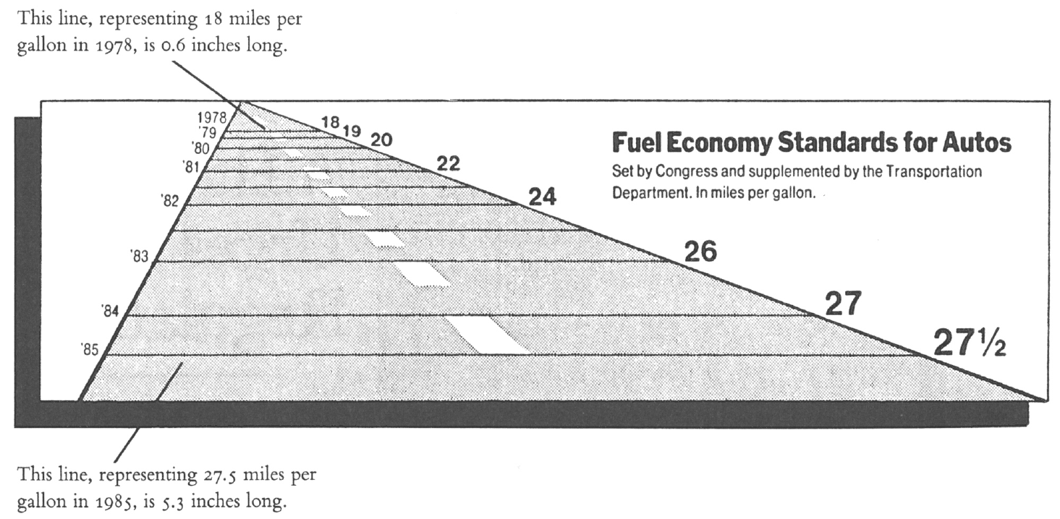
Figure: New York Times, 9 August 1978, p. D-2
Tufte, ER 2001 The visual display of quantitative information, p. 57-59

Slide 6
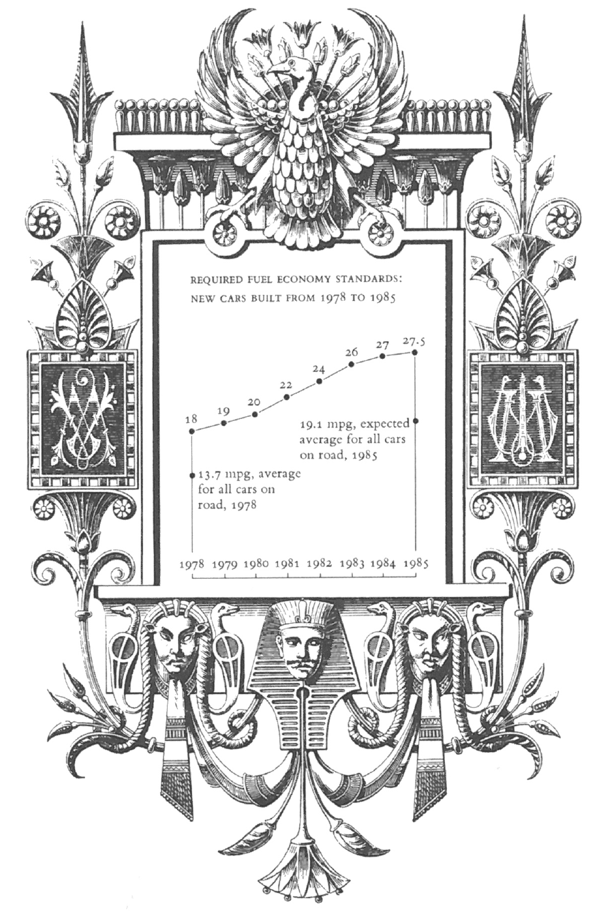
“Here there are many decorations, but no lies”
Tufte, ER 2001 The visual display of quantitative information, p. 59

Slide 7
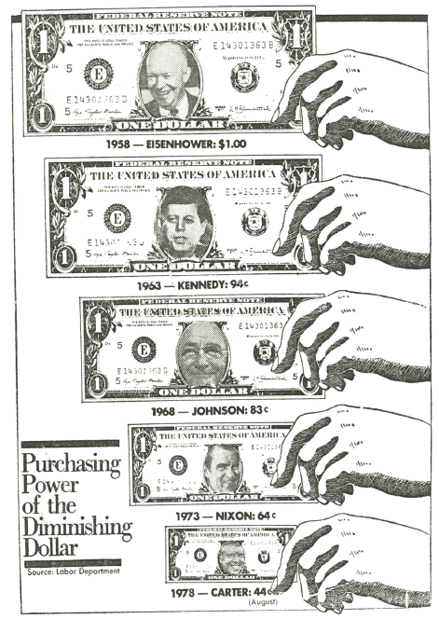
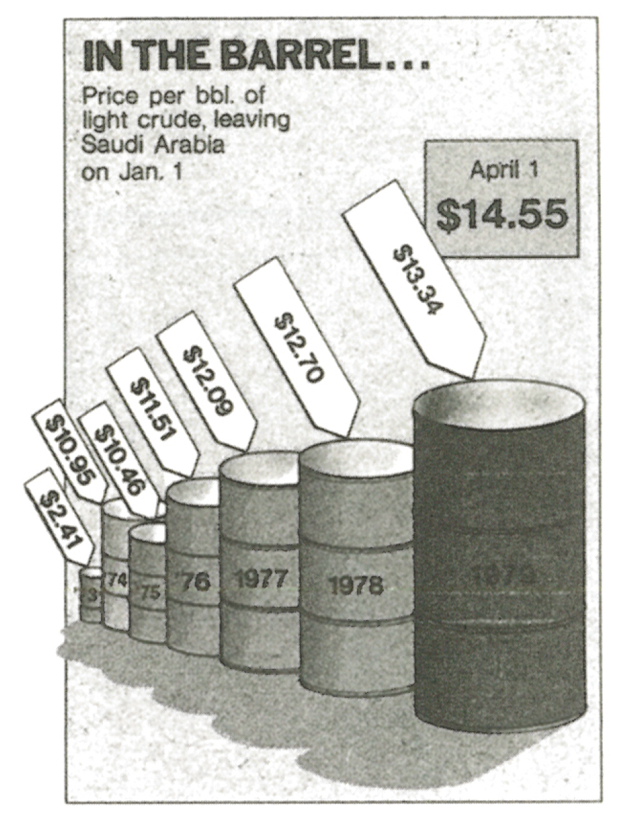
1978 dollar should be 2 X
Lie Factor 9.5… by volume 59.4
Washington Post, October 25, 1978, p. 1
New York Times, January 27, 1981, p. D-1
Tufte, ER 2001 The visual display of quantitative information, p. 70-71
Notes:
Principle: The number of information carrying dimensions depicted should not exceed the number of dimensions in the data

Slide 8
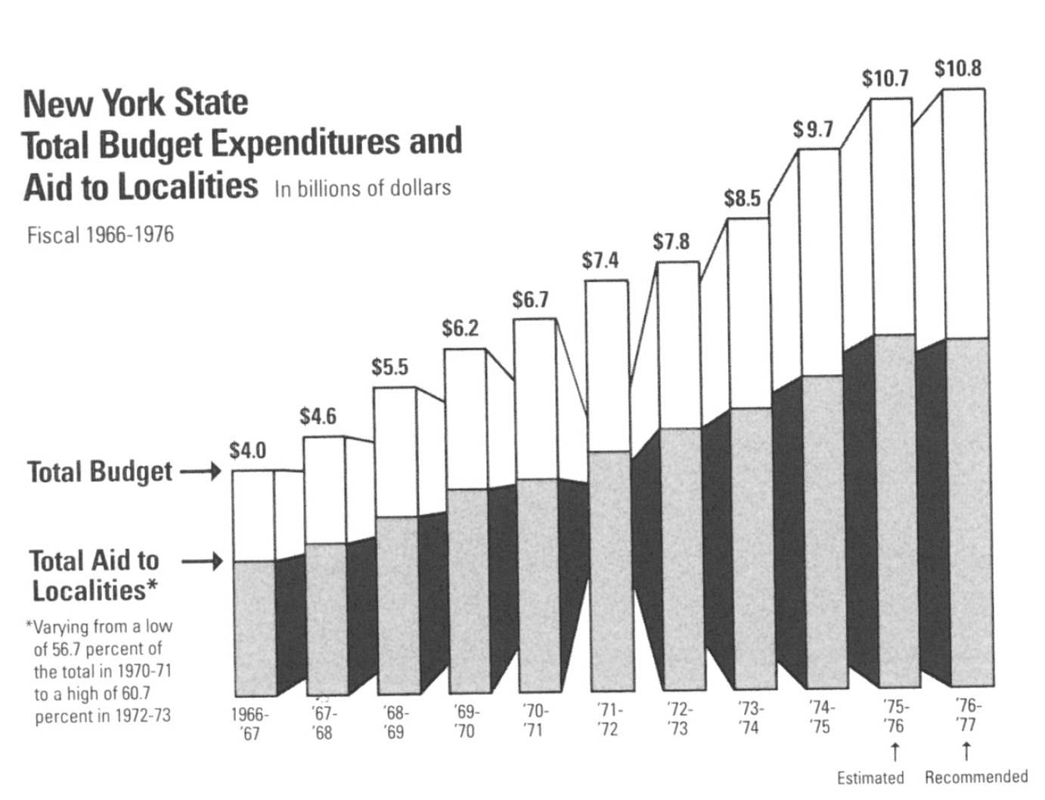
Chartjunk and exaggeration
“The Graph of the Magical Parallelipipeds”
Inflation +103%
Population +10%
Tufte, ER 2001 The visual display of quantitative information, p. 66
Notes:
New York state expenditure: the Graph of Magic Parallelipeds:
chartjunk
inflation (103%)
population growth (10%)
distortion

Slide 9
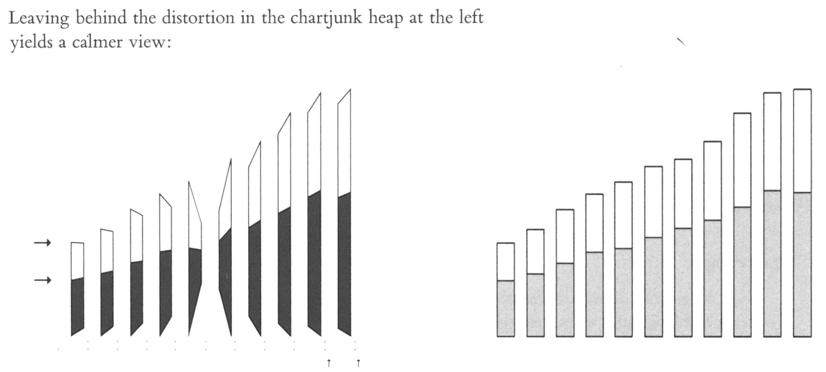
Tufte, ER 2001 The visual display of quantitative information, p. 67

Slide 10
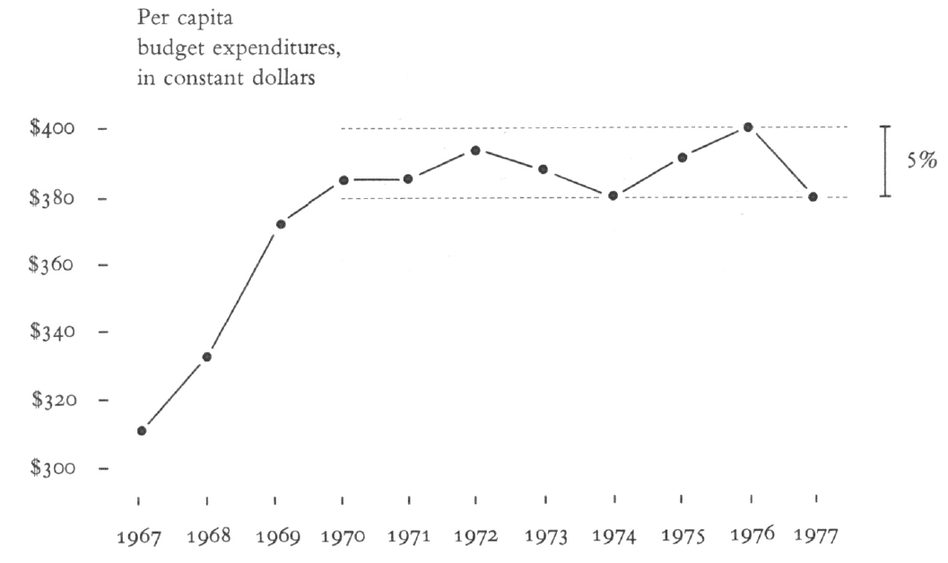
Tufte, ER 2001 The visual display of quantitative information, p. 68
Notes:
Principle: in time-series displays of money, deflated and standardized units of monetary measurement are nearly always better than nominal units.

Slide 11
“In time-series displays of money, deflated and standardized units of monetary measurement are nearly always better than nominal units”
Tufte, ER 2001 The visual display of quantitative information, p. 68

Slide 12
Tufte, ER 2001 The visual display of quantitative information, p. 93-95
Notes:
Maximize the data-ink ratio, within reason
Erase non-data-ink, within reason
Erase redundant data-ink, within reason

Slide 13
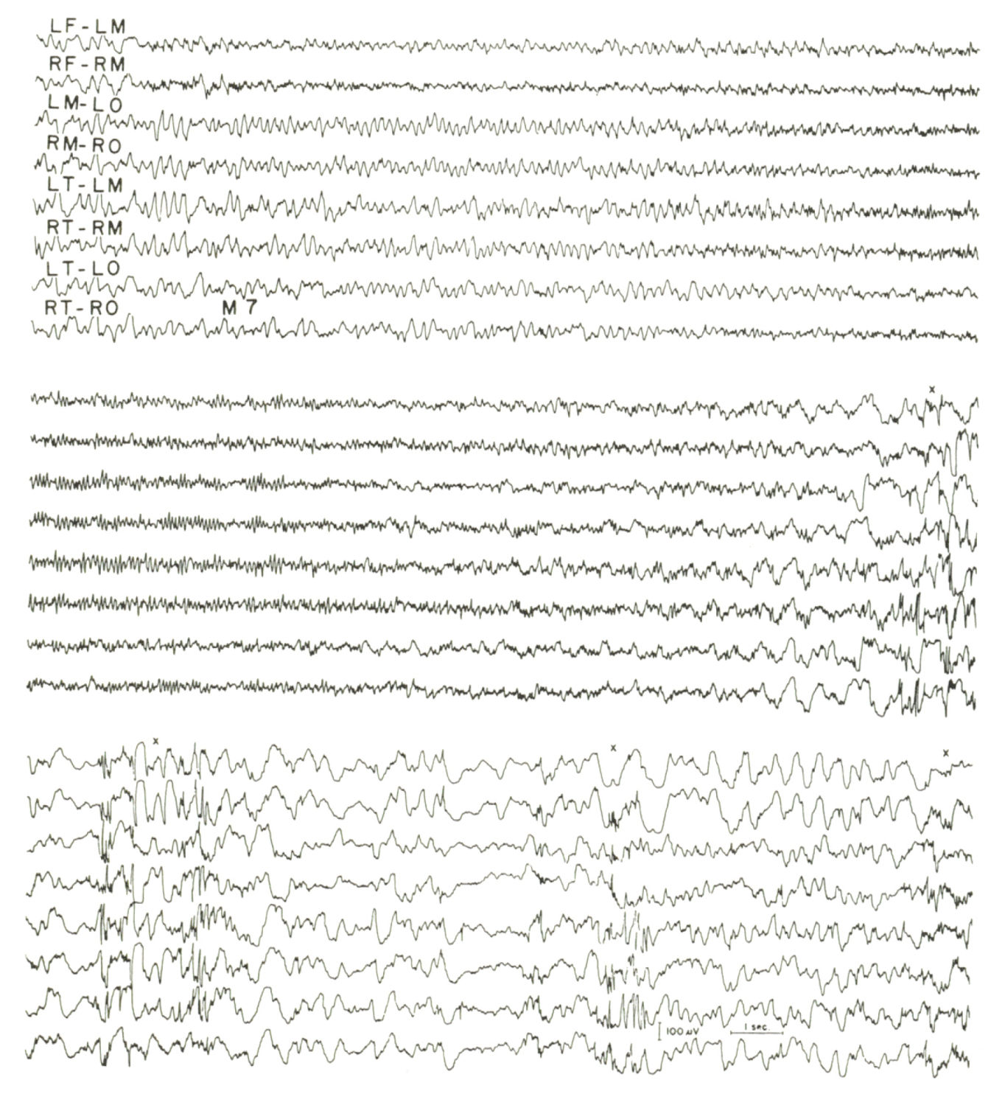
axes
Kooi, KA 1971 Fundamentals of electroencephalography, New York, p. 110
Tufte, ER 2001 The visual display of quantitative information, p. 93
Notes:
Maximize the data-ink ratio, within reason
Erase non-data-ink, within reason
Erase redundant data-ink, within reason

Slide 14
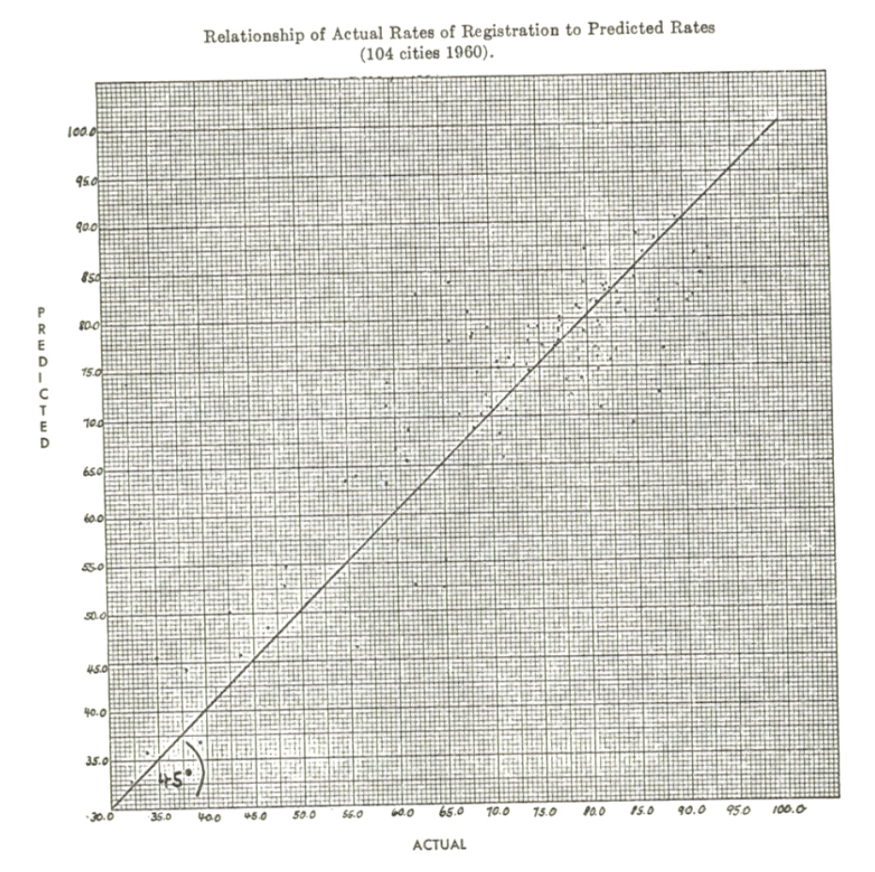
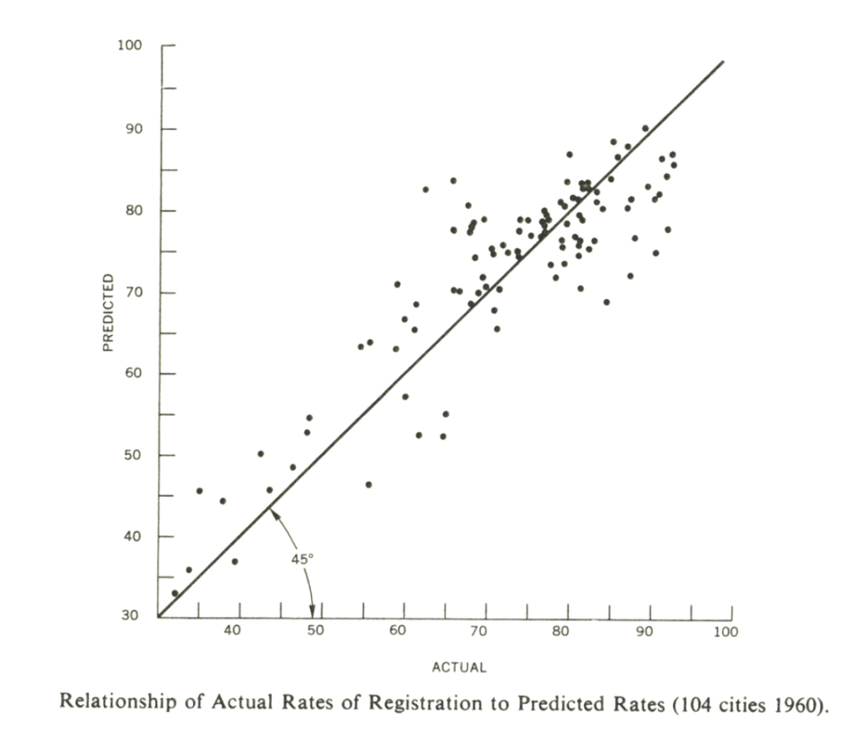
Kelley & Bowen 1967 American Political Science Review, 61:371
Tufte, ER 2001 The visual display of quantitative information, p. 94-95
Notes:
Maximize the data-ink ratio, within reason
Erase non-data-ink, within reason
Erase redundant data-ink, within reason

Slide 15
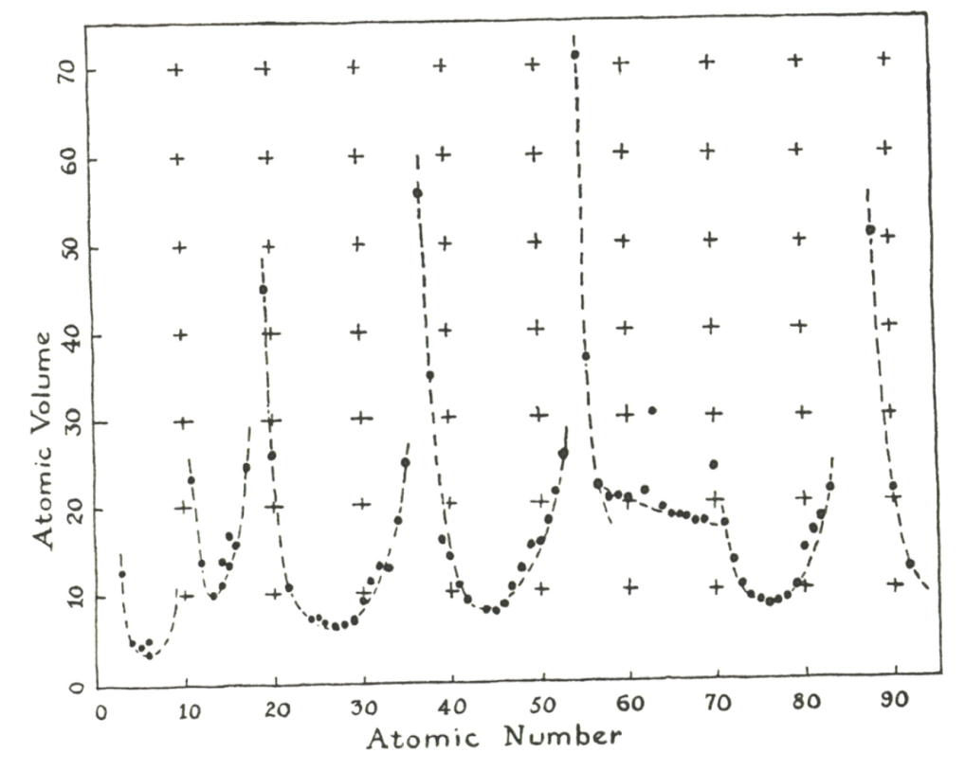
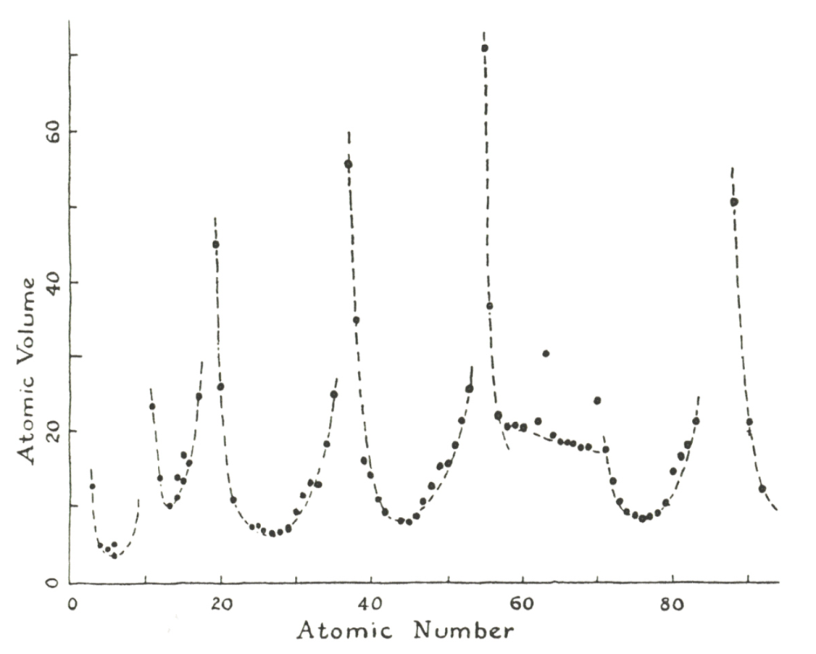
Data-ink ratio: < 0.6
Data-ink ratio: 0.9
Pauling, L 1947 General chemistry, San Francisco, p. 64
Tufte, ER 2001 The visual display of quantitative information, p. 102-105
Notes:
Maximize the data-ink ratio, within reason
Erase non-data-ink, within reason
Erase redundant data-ink, within reason

Slide 16
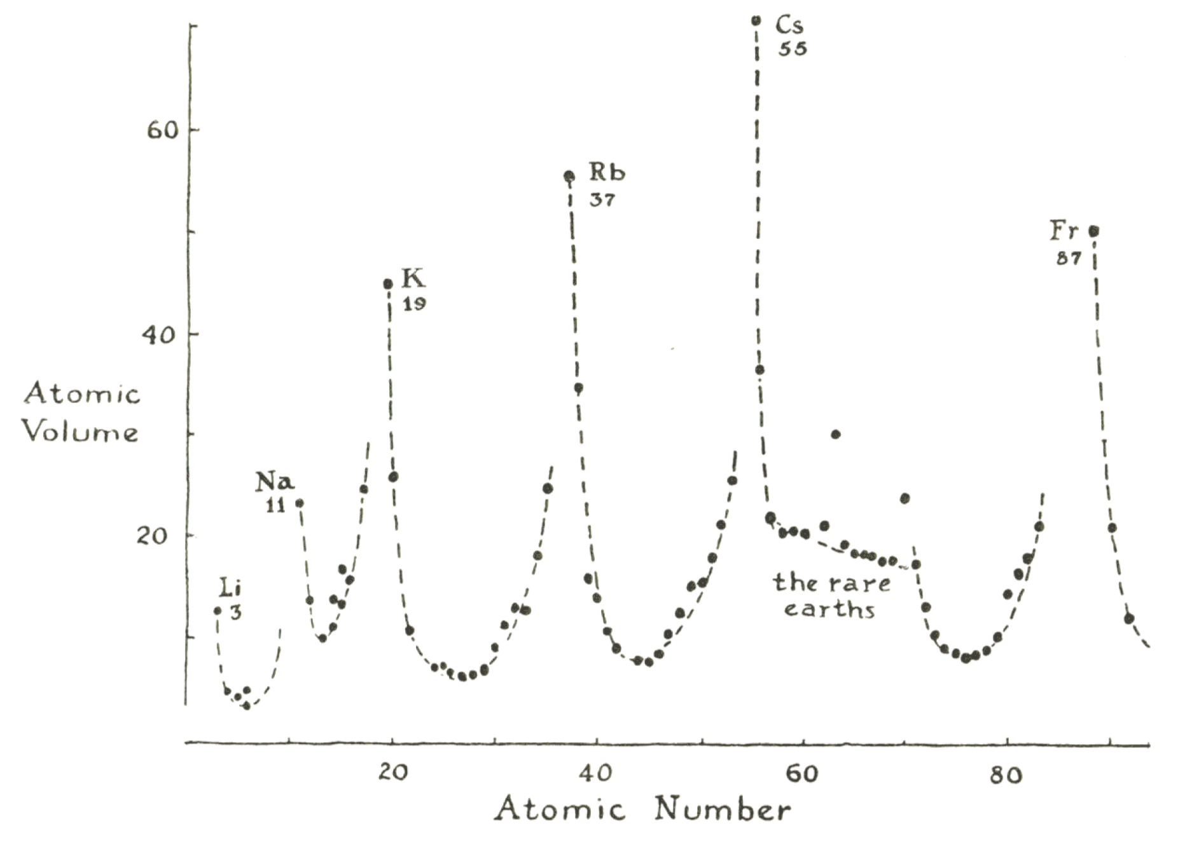
Tufte, ER 2001 The visual display of quantitative information, p. 102-105
Notes:
Maximize the data-ink ratio, within reason
Erase non-data-ink, within reason
Erase redundant data-ink, within reason

Slide 17
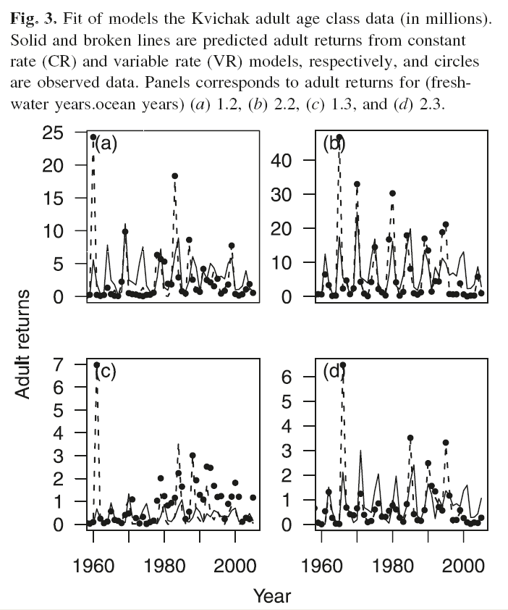
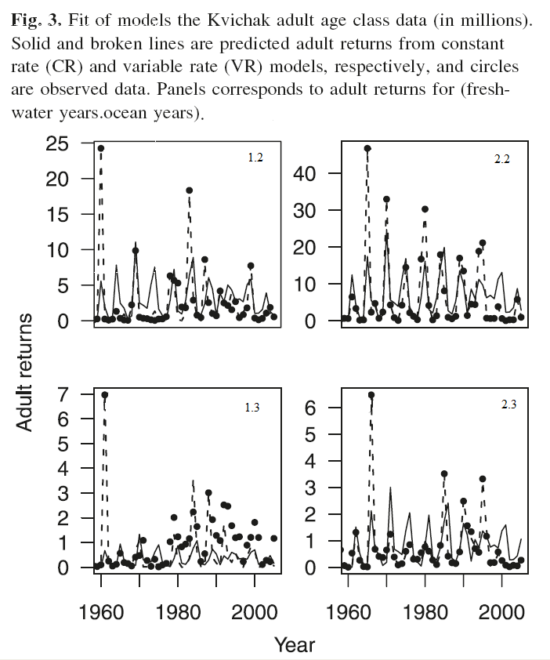
Label the figures, not the legends
1.2
2.2
1.3
2.3
CJFAS-mandated style
Labels directly on subplots
Lessard et al. 2008 CJFAS 65:2269-2278

Slide 18
Principles of graphics design
Above all else show the data
Maximize the data-ink ratio
Erase non-data-ink
Erase redundant data-ink
Revise and edit
Tufte, ER 2001 The visual display of quantitative information, p. 105

Slide 19
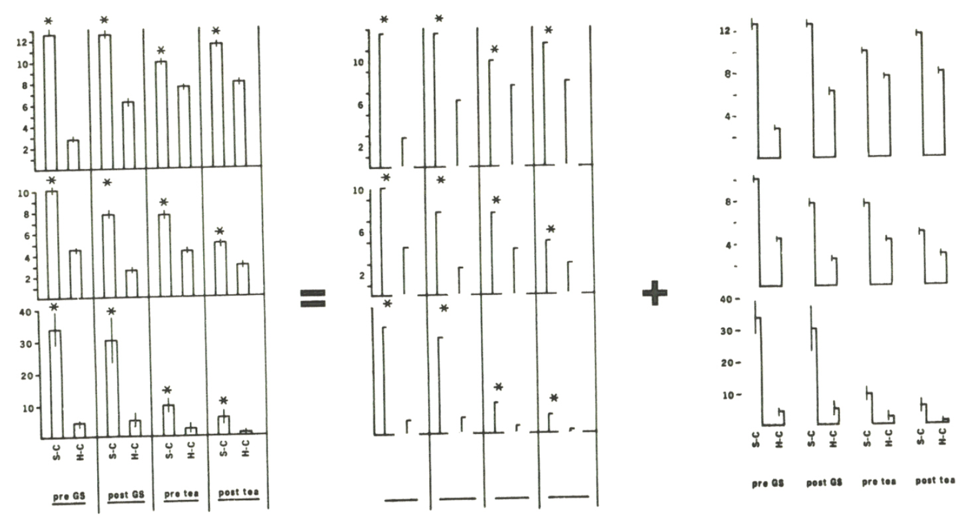
Barplots 1
Kuznicki & McCutcheon 1979 Journal of Experimental Psychology: General, 108:76
Tufte, ER 2001 The visual display of quantitative information, p. 102
Notes:
Maximize the data-ink ratio, within reason
Erase non-data-ink, within reason
Erase redundant data-ink, within reason

Slide 20
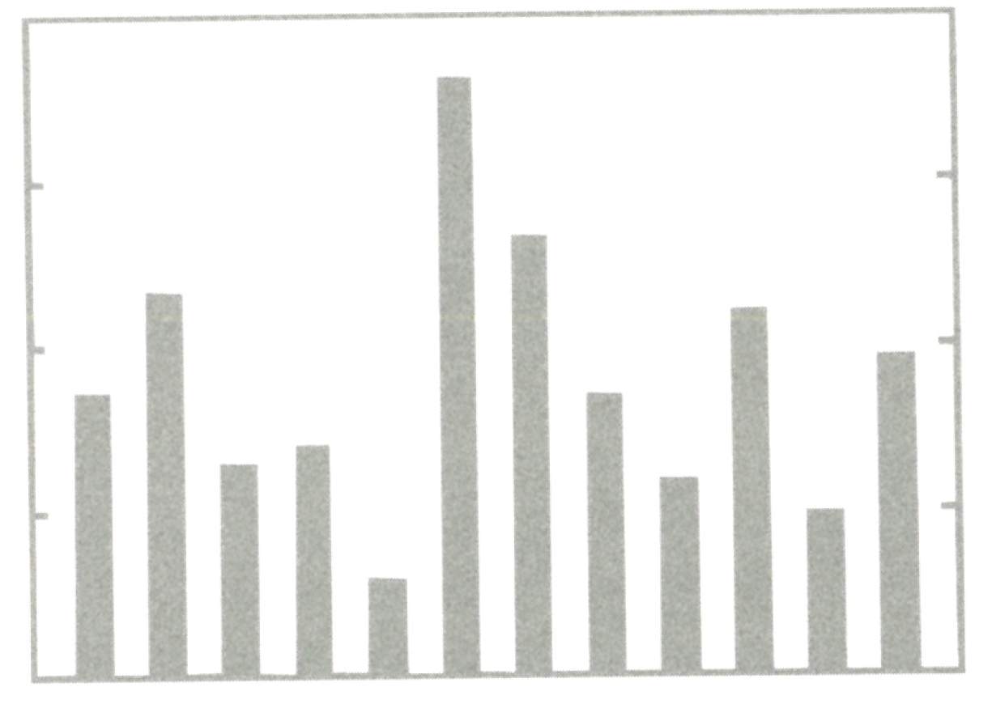
Barplots 2
Tufte, ER 2001 The visual display of quantitative information, p. 126-128
Notes:
Delete colors give the y-tics

Slide 21
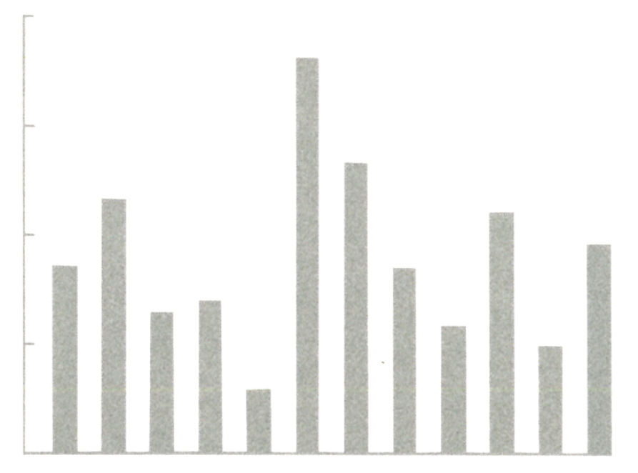
Erase the box
Tufte, ER 2001 The visual display of quantitative information, p. 126-128
Notes:
Delete colors give the y-tics

Slide 22
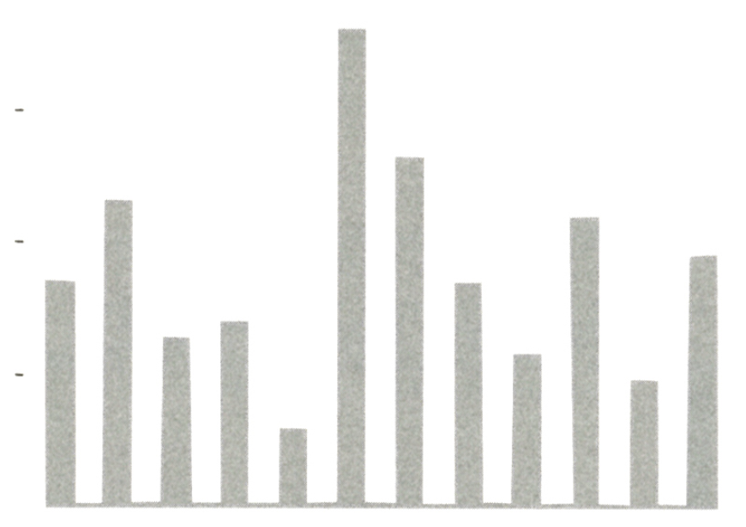
Leave only the tick marks
Tufte, ER 2001 The visual display of quantitative information, p. 126-128
Notes:
Delete colors give the y-tics

Slide 23
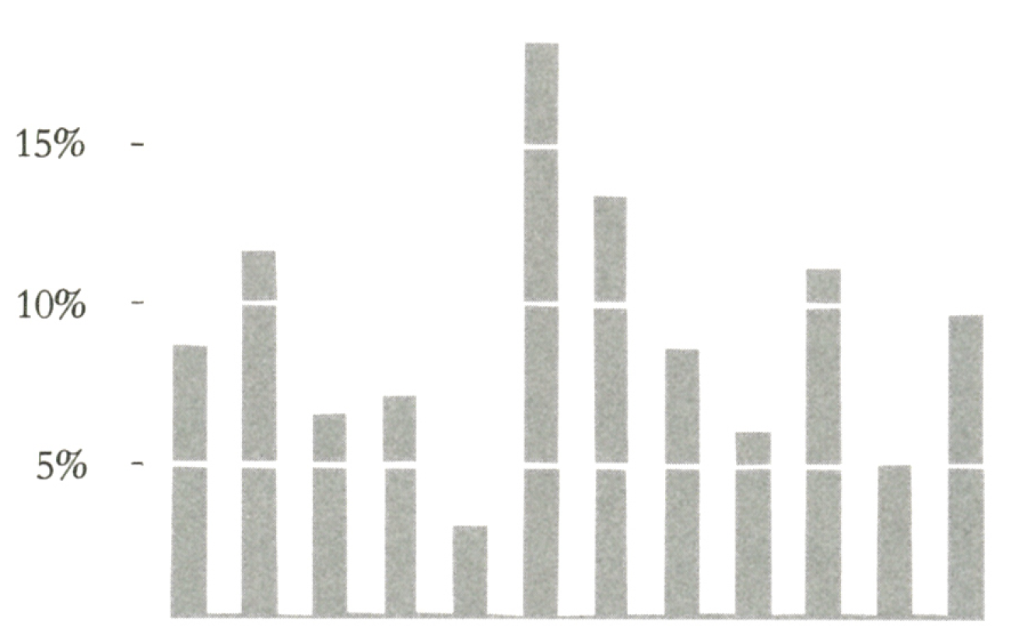
Erase some data to make a white grid
Tufte, ER 2001 The visual display of quantitative information, p. 126-128
Notes:
Delete colors give the y-tics

Slide 24
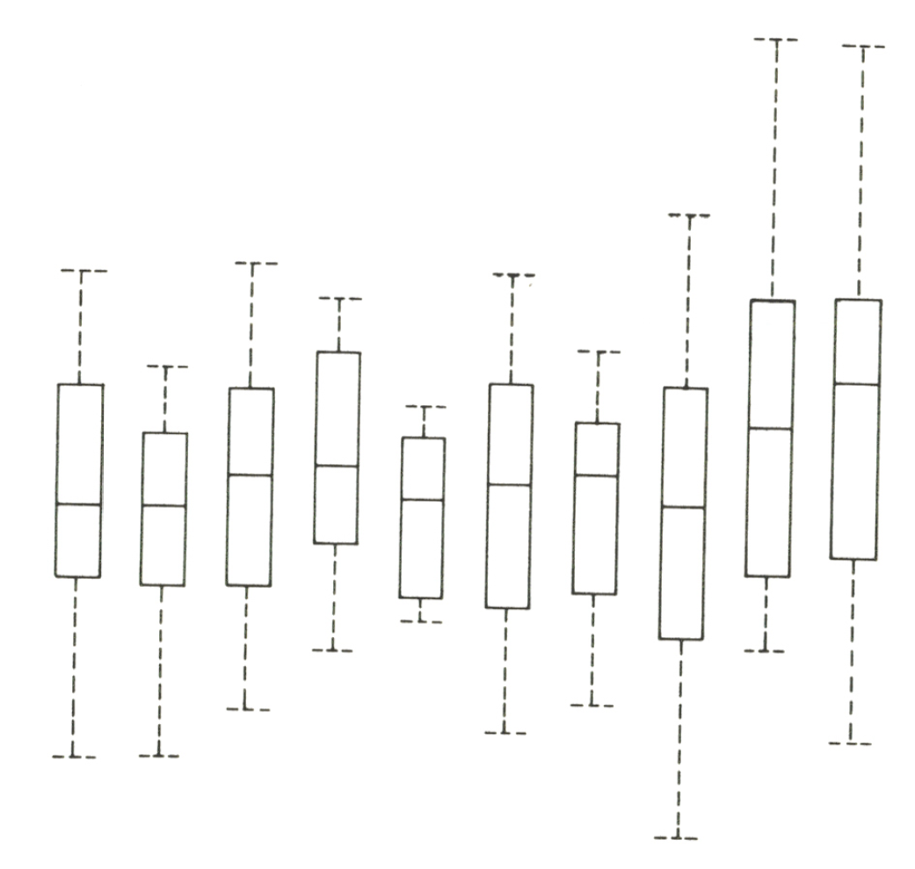
Parallel boxplots
Tufte, ER 2001 The visual display of quantitative information, p. 125
Notes:
Original has 50 horizontals and 30 vertical lines, revised needs only 10 verticals to show the same data. Relevant on informal, exploratory data analysis, where the research workers time should be devoted to matters other than drawing lines.

Slide 25
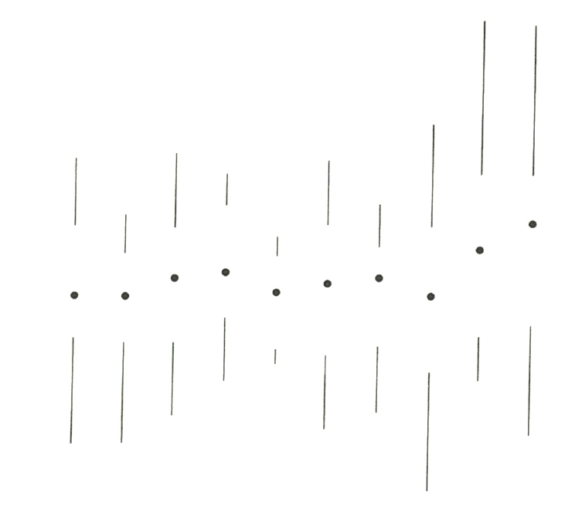
Parallel boxplots
“Original has 50 horizontals and 30 vertical lines,
revised needs only 10 verticals to show the same data”
Tufte, ER 2001 The visual display of quantitative information, p. 125
Notes:
Original has 50 horizontals and 30 vertical lines, revised needs only 10 verticals to show the same data. Relevant on informal, exploratory data analysis, where the research workers time should be devoted to matters other than drawing lines.

Slide 26
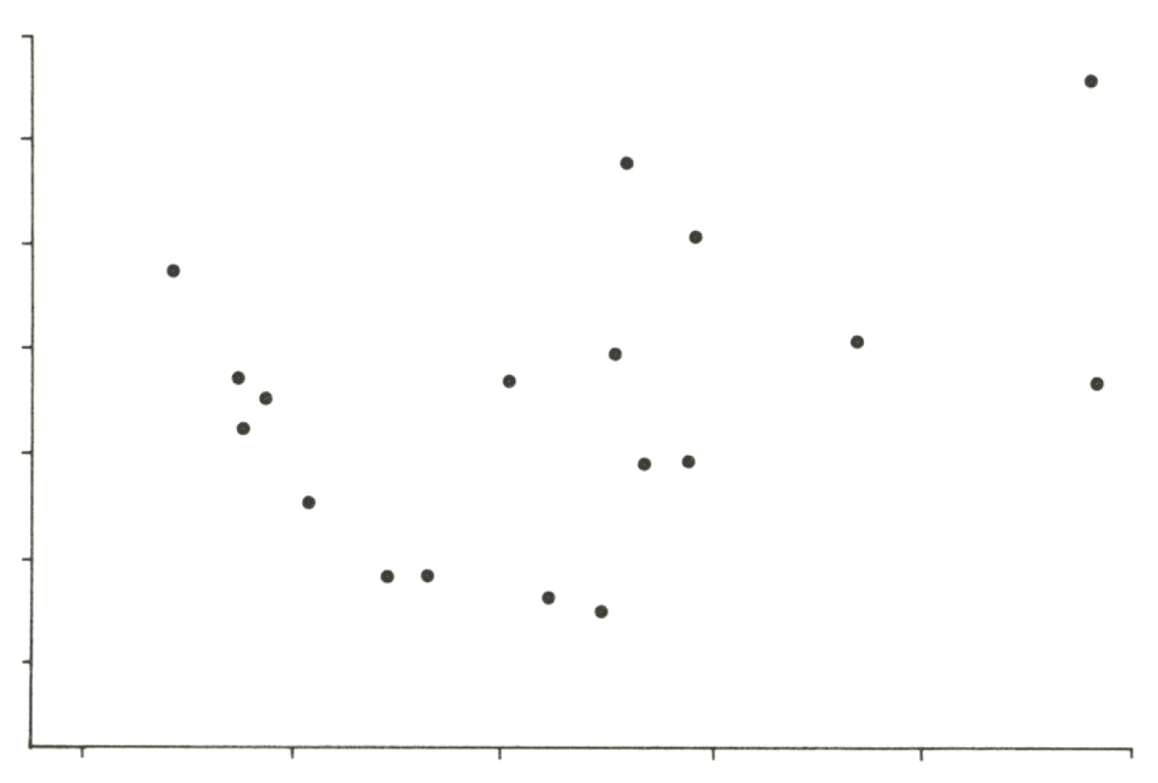
Scatterplots
Tufte, ER 2001 The visual display of quantitative information, p. 130-133
Notes:
Axes double as quartile plots for displaying marginals of the plot (p.132).

Slide 27
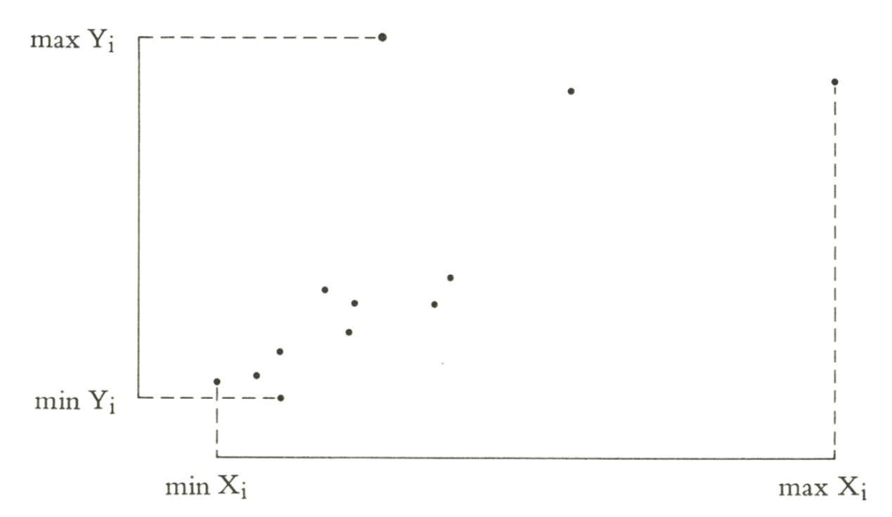
Scatterplots
Tufte, ER 2001 The visual display of quantitative information, p. 130-133
Notes:
Axes double as quartile plots for displaying marginals of the plot (p.132).

Slide 28
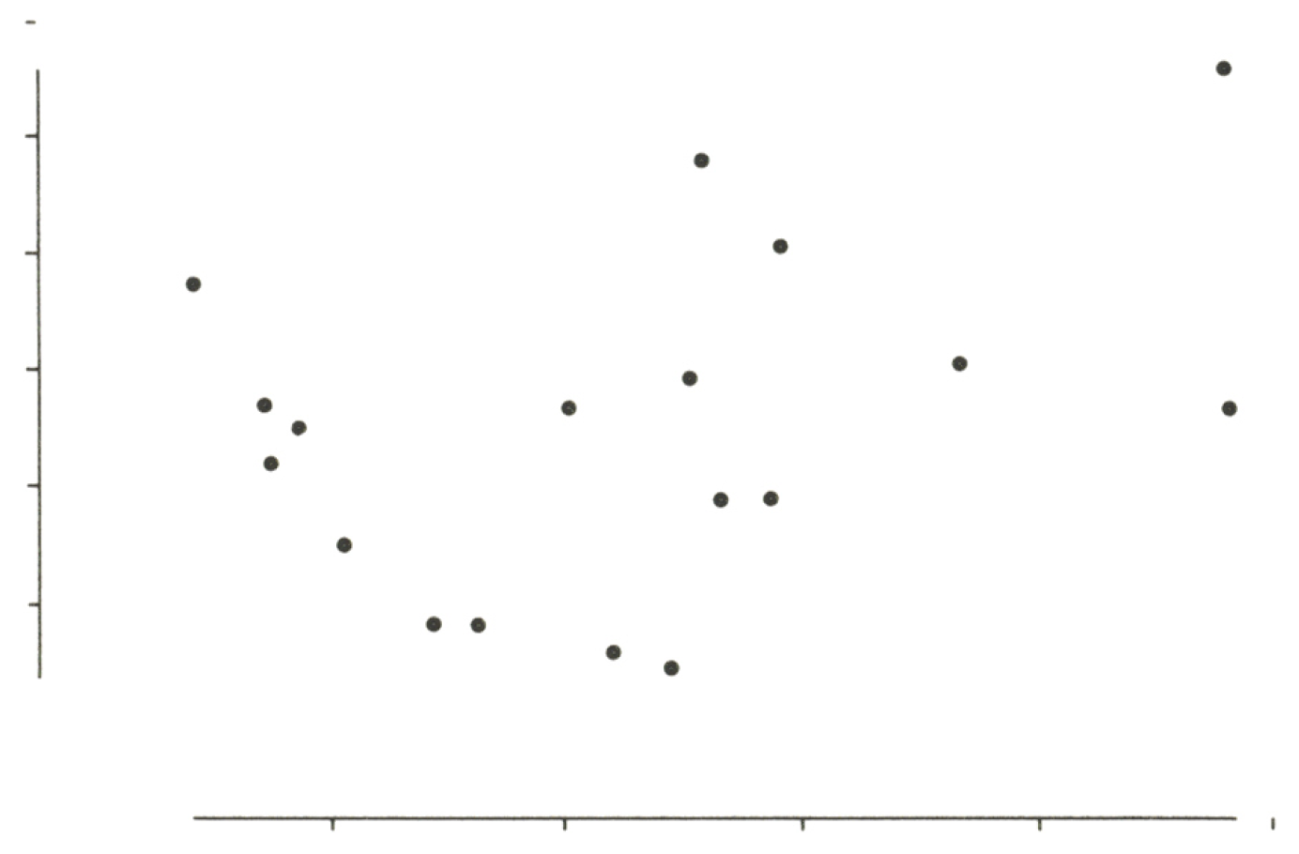
Scatterplots
Tufte, ER 2001 The visual display of quantitative information, p. 130-133
Notes:
Axes double as quartile plots for displaying marginals of the plot (p.132).

Slide 29
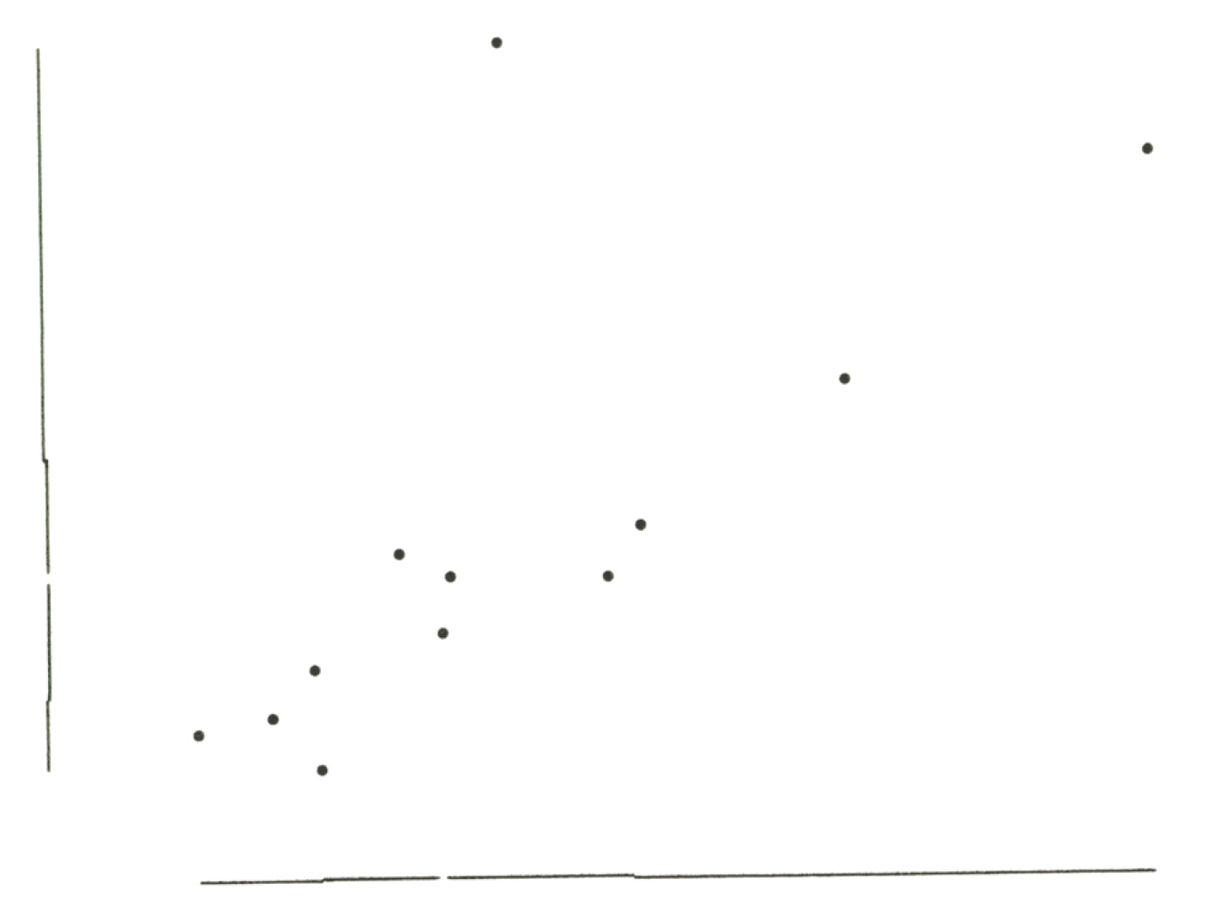
Turn axes into quartiles
Tufte, ER 2001 The visual display of quantitative information, p. 133
Notes:
Axes double as quartile plots for displaying marginals of the plot (p.132).

Slide 30
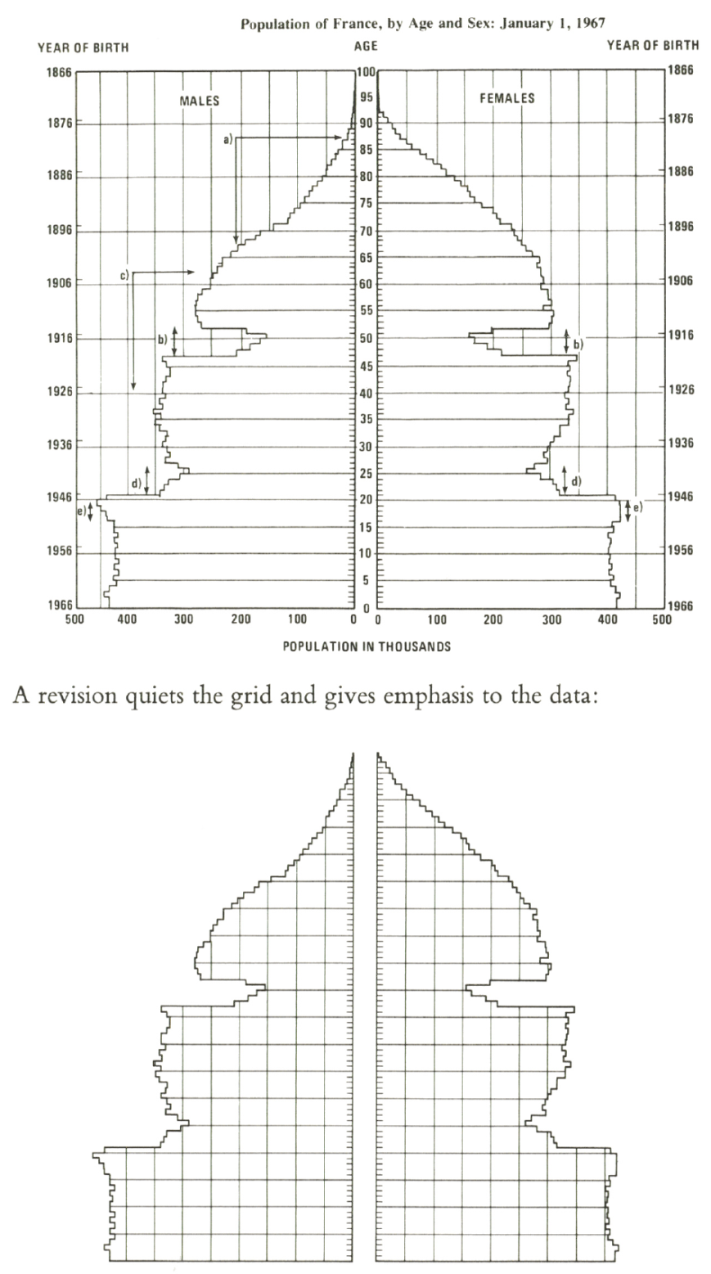
Age distribution of the population of France
Tufte, ER 2001 The visual display of quantitative information, p. 113
Notes:
Rather use tint shades of gray, or encode with labels on the graphic.

Slide 31
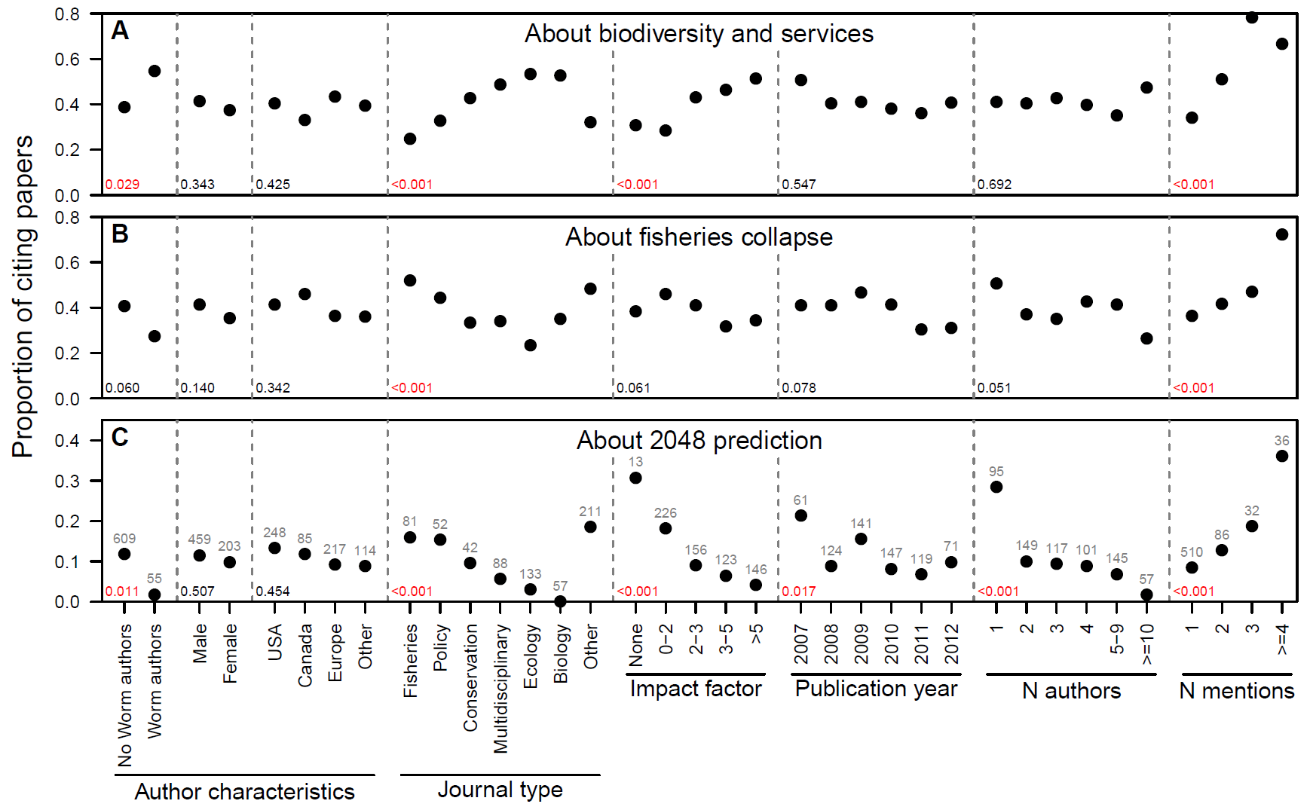
How do people cite Worm et al. (2006)?
P-value
Sample size
Analysis of Worm, B. (2006) Science 314:787-790
Figure: Branch, T.A. unpublished analysis

